Slide 1
Bridges
4th Grade Instructional Seminar!

Slide 2
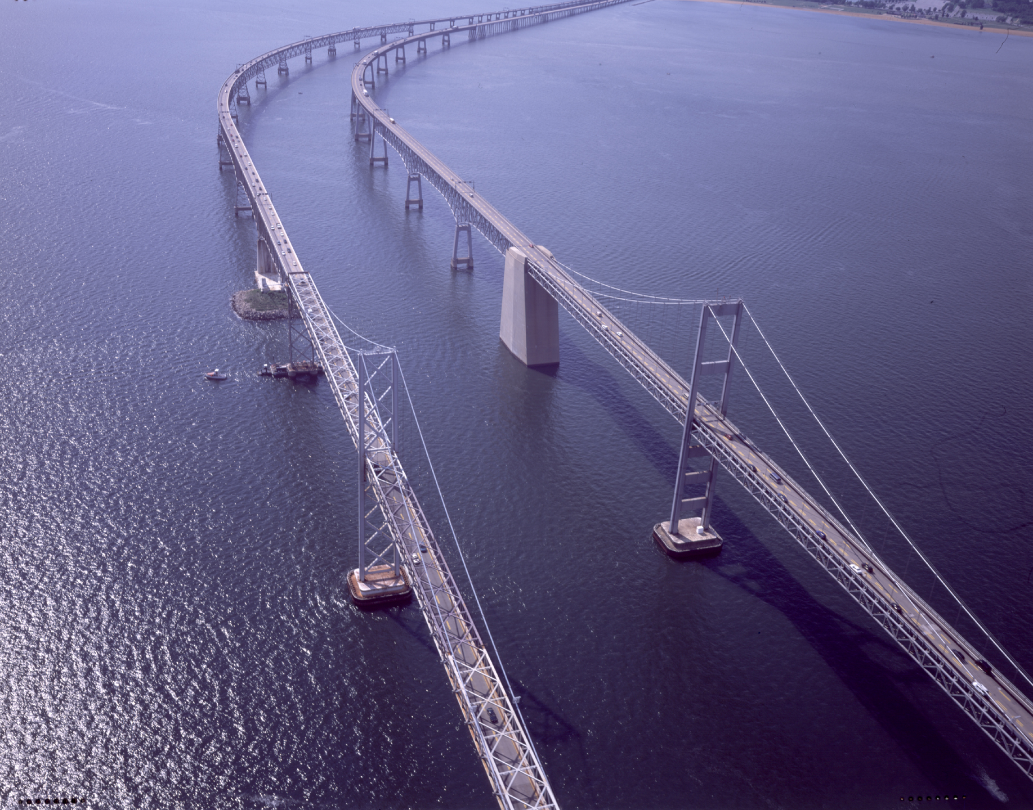
Bay Bridge, MD

Slide 3
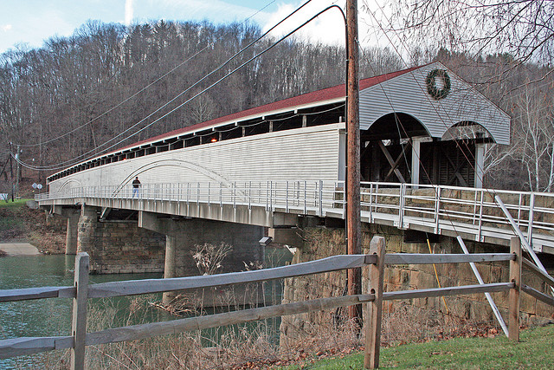
Philippi Covered Bridge, WV

Slide 4
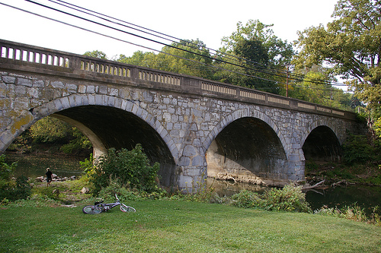
Stone Arch Bridge, MD

Slide 5
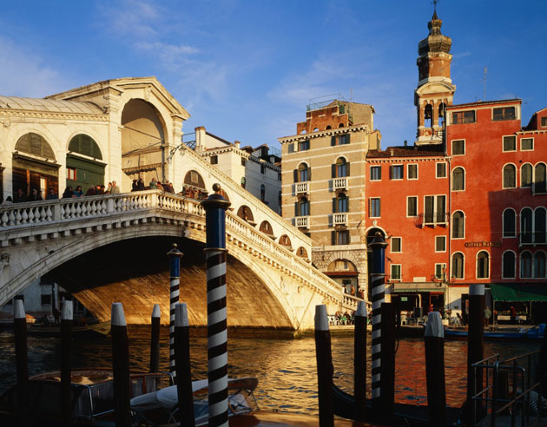
Rialto Bridge, Italy

Slide 6
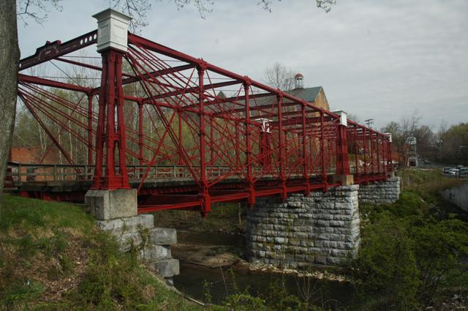
Bollman Truss Suspension Bridge, MD

Slide 7
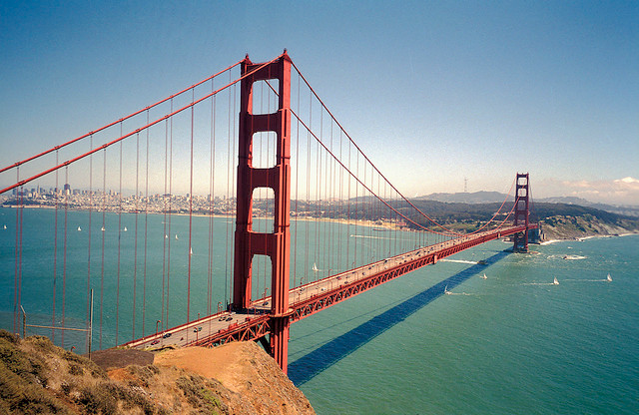
Golden Gate Bridge, CA

Slide 8
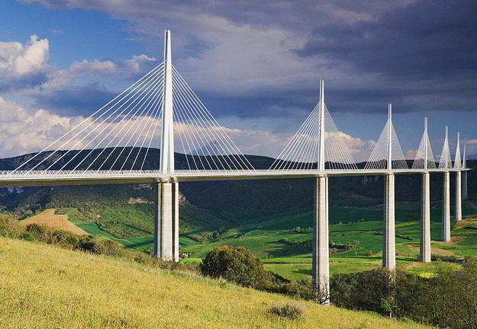
Millau Bridge, France

Slide 9
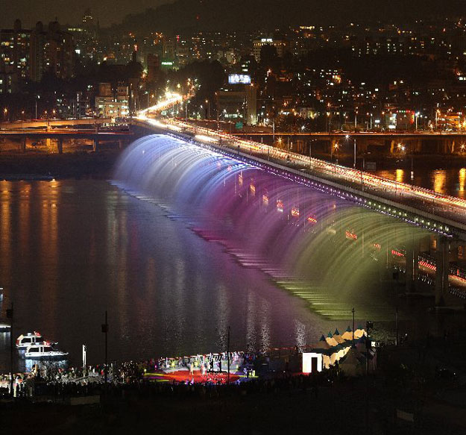
Banpo Bridge, South Korea

Slide 10
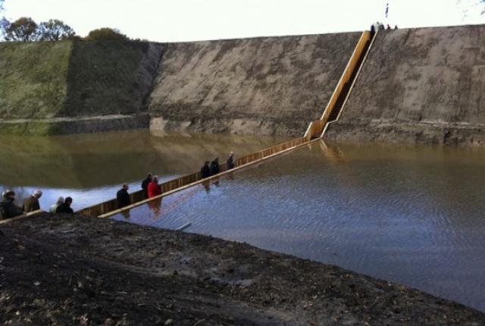
The Moses Bridge, Netherlands

Slide 11
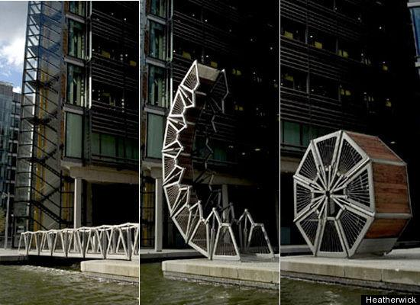
Rolling Bridge, England

Slide 12
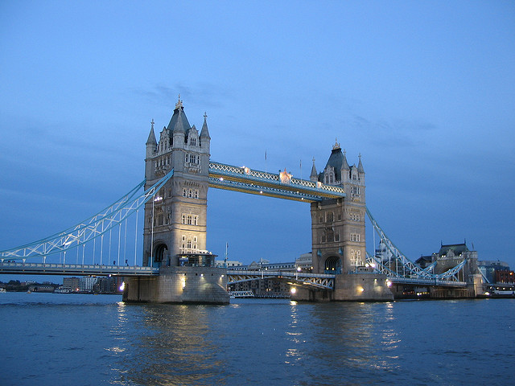
Tower Bridge, London

Slide 13
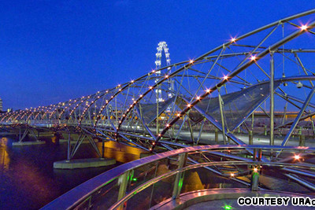
The Helix Bridge, Singapore

Slide 14
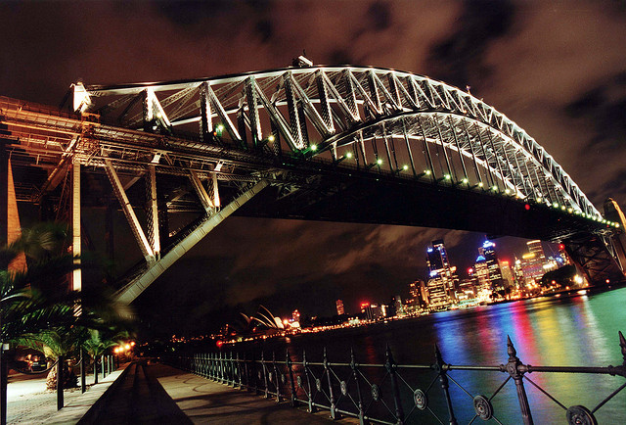
Sydney Harbor Bridge, Australia

Slide 15
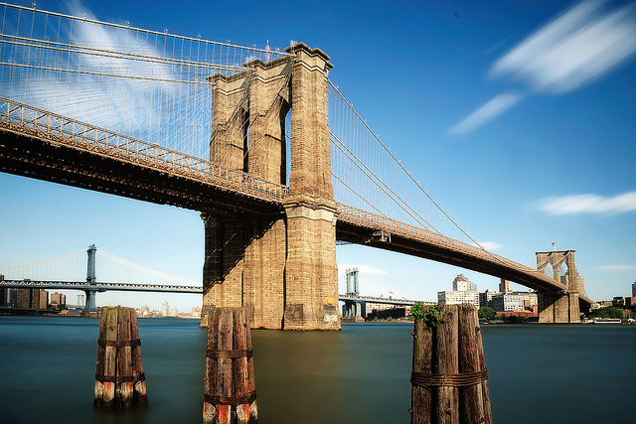
Brooklyn Bridge, NY

